Slide 1
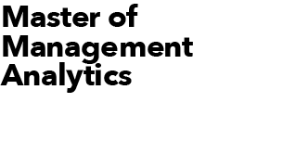
Sobss: ANALYSIS OF effectiveness of bRANDED PAID SEARCH
Team Techie Prophets
Lily Liu, Junduo Dong, James Chen

Slide 2
INTRODUCTION
Business Objectives & Problems
Company
SOBSS is a cloud-based Software as a service (SaaS) company provides a variety of basic business software
Major clients of SOBSS’s are small and medium-sized companies in the US and Canada
Marketing Strategy
Drive customer traffic to its website by SEO, Branded Paid Search(PS), Non-Branded PS, etc.
Motivate potential customers to sign up free trials
Convert customers using free trials to renew subscription as paying customers
Problems
CEO and CMO can not reach an agreement about whether continue to invest in Branded PS in the next Fiscal Year
CMO insists that Branded PS is the most efficient marketing channel
CEO, however, argues that marketing spend on Branded PS is misguided and he predicts when Branded PS turn off customers will find the website through organic search, therefore spending should be redirected to Non-Branded PS or other channels

Slide 3
ANALYSIS
Marketing efficiency: Branded PS vs Non-Branded PS
Marketing spending of Non-Braded PS is 17 times more than Branded PS, but only achieved maximally 5 times of conversion rate than Branded PS, Brand PS is more efficient than Non-branded PS

Slide 4
ANALYSIS
ROI of Branded PS is increasing year over year in both Canada and US
Assume customer base is 2,000 in year 1, ROIs of branded PS is projected from 1st year to 5th year
4

Slide 5
ANALYSIS
Will SEO compensates when PPC Branded shuts off?
SEO is able to compensate for Branded PS in Canada market, however, it failed to compensate Branded PS in the US market
PPC Branded Function: ON = test, OFF = control

Slide 6
ANALYSIS
CTR & Conversion Rate: PPC Branded VS SEO
CTR (Click through rate) defines the ratio that out of all users how many new visitors click the ads
Conversion rate defines the ratio of how many new users sign up for a free trail
Left chart shows CTR(PPC Branded) is significantly higher than SEO, and Conversion rate(PPC Branded) is slightly higher than SEO. This can illustrate that branded PS can attract more customers than SEO

Slide 7
RESULTS & RECOMMENDATIONS
Results
Branded PS channel drives more customer traffic to its website (higher CTR), and motivates more customers to sign up free trials (higher Conversion rate)
ROI for Branded PS keep rising year over year in both Canada and the US market
SEO was able to compensate for Branded PS in Canada market, however, it failed to compensate Branded PS in the US market
Recommendations
Based on our solid statistical analysis, we recommend SOBSS gradually reduce marketing spending of PS Branded in Canada, but increase marketing spend in the US market
We recommend that the company strengthen its UI design on their homepage to maximize user conversion. The method can be change the position, size and color of the “Try Free Trail” button and content on the page, etc. Therefore, we can get more trials and get a more convincing true difference that the conversion rate is higher from PPC branded than SEO
If marketing budget allows, we suggest SOBSS conduct another PS experiment around January to collect more data source, which controls seasonality and makes analysis more trustworthy

Slide 8
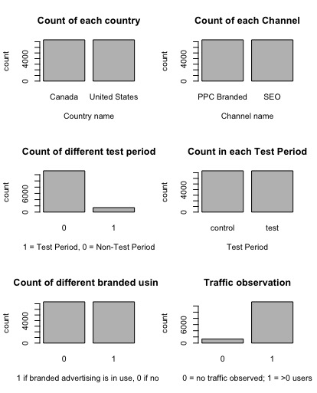
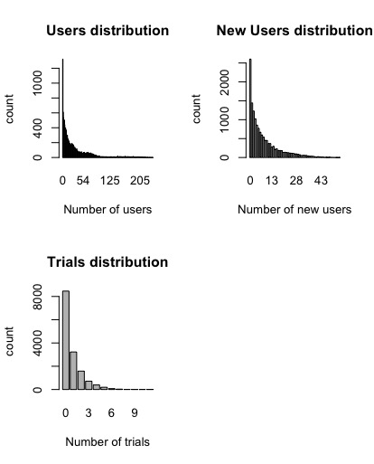
Appendix #1: Data Source and Data Exploration
Brief description of all the data source we have for this project
Our analysis is based on two data sources, one is the Profile of North American customers (Exhibit1) and SOBSS’ Marketing Result for FY2016 (Exhibit2), the other is the given excel data source from May 2017 to September 2017
Below is the brief description of each column in ’SOBSS data’ excel data source:
Variable name | Description | Values
Country | Identified based on IP address | Canada, US
Channel | PPC Branded or SEO | PPC Branded or SEO
Year | Years in the dataset | 2017
Month | Months in the dataset | 5,6,7,8,9
Day | Days in the dataset | 1,2,3,,,,,,,, 31
Hour | First: 0, last: 23 | 0,1,2,,,,,,,,, 23
Test Period | 1 = Test Period, 0 = Non-Test Period | 0,1
Hour Designation | Apples only during the test period | Control, test
BRAND_ads_ON_Flag | 1 if branded advertising is in use, 0 if not | 0,1
Cnt_obsrv | 0 = no traffic observed; 1 = >0 users | 0,1
Users | Total number of website visitors | 1,,,,,,, 258
New Users | Number of visitors who are not already clients | 1,,,,,,, 71
Trials | Number of new users signing up for free trial | 1,,,,,,, 13

Slide 9
Appendix #2 ROI Calculations
How do we calculate ROI for branded PS
New Customer = Trials for the previous yr * 10%
New Customer | 1yr | 2yr | 3yr | 4yr | 5yr
Canada | 0 | 370 | 370 | 370 | 370
US | 0 | 717 | 717 | 717 | 717
Total | 0 | 1115 | 1115 | 1115 | 1115
The rational behind ROI calculation is solid and explained below:
We set up first year customer base to 2,000
We use number of trials and new users from 2017. 05 as an example to predict volume of trials and new users in one year
We assume CPC continue to rise 30% Y/Y in next few years
Left table shows full picture of ROI calculation
Customer Base = 85% of customer base from the previous year + 10% of trials
Customer Base | 1yr | 2yr | 3yr | 4yr | 5yr
Canada | 500 | 795 | 1,045 | 1,258 | 1,439
US | 1,500 | 1,917 | 2,250 | 2,516 | 2,730
Total | 2,000 | 2,735 | 3,330 | 3,811 | 4,202
Return = Customer base * Avg. Monthly Rev. *12 month
Return | 1yr | 2yr | 3yr | 4yr | 5yr
Canada | $240,000 | $381,408 | $501,605 | $603,772 | $690,614
US | $1,080,000 | $1,379,894 | $1,619,810 | $1,811,742 | $1,965,288
Total | $1,320,000 | $1,804,810 | $2,197,505 | $2,515,589 | $2,773,237
Cost = Trial * CPT+New User*CPC
Cost | 1yr | 2yr | 3yr | 4yr | 5yr
Canada | $376,152 | $387,179 | $401,514 | $420,149 | $444,375
US | $1,130,227 | $1,144,528 | $1,163,120 | $1,187,288 | $1,218,708
Total | $1,587,421 | $1,646,864 | $1,724,140 | $1,824,599 | $1,955,196
ROI=(Return-Cost)/Cost | 1yr | 2yr | 3yr | 4yr | 5yr
Canada | -13.90% | 31.63% | 64.95% | 87.08% | 99.05%
US | 9.52% | 37.93% | 58.96% | 73.68% | 82.89%
Total | -6.68% | 22.44% | 41.66% | 52.30% | 55.60%
9
10/9/19

Slide 10
Appendix #3: Statistical Testing
references to all the test of independences & significant differences
By using the method of test of independences, we are able to find out influences between different levels in each categorical variables with Trials.
Conclusion 1 : The total trials is dependent with Country (US / Canada)
Result: by using chi-square independent test, the total number of trials does not influence by country
Conclusion 2: The total trials is dependent with Channel (PPS Branded / SEO)
Result: by using chi-square independent test, the total number of trials in each channel is not independent
Conclusion 3: The total trails is dependent with Time Period (Pre / Test / Post)
Result: by using chi-square independent test, the performance of total number of trials in each experiment time period is not independent
Significant difference between the means of two groups was tested by t-test, which is a type of inferential statistic
Conclusion 1: During the ‘test’ time period, if I turn off the PPC Branded, the click through rate and conversion rate will not be the same with SEO
Result: using independent t-test, the click through rate of users from PPC Branded will less than SEO about 19.79% averagely and conversion rate is less about 5.14%
Conclusion 2: During pre, test and post time period, if I turn off PPC Branded, the click through rate from PPC Branded is less than SEO
Result: using dependent t-test, the true difference between SEO and PPC Branded is not equals to 0 and the click through rate of users from PPC Branded will less than SEO about 11.89% averagely
Conclusion 3: During test time period, if I turn on the PPC Branded, the conversion of PPC Branded is higher than SEO
Result: using independent test, the click through rate of PPC Branded is higher than turned off about 11% averagely in Canada and 14% in United States. The conversion rate is higher about 2% in Canada and 1.5% in United States.
Conclusion 4: During pre, test and post time period, if I turn off PPC Branded, the conversion of trials in each country will not be the same between PPC Branded and SEO
Result: using dependent test, we detect the click through rate of PPC Branded in Canada is higher than SEO about 11.28% and the click through rate of PPC Branded is 12.5% higher than SEO in United States

